Slide 1
MSc Statistics Foundation Course 2015 Methods of Estimation
Dr Franz J. Király

Slide 2
Schedule
2:30-3:45 pm Part I Parametric Estimation, Bias and Variance, Method of Moments
3:45-4:15 pm Break
4:15-5:30 pm Part II Maximum Likelihood Estimation, Confidence Intervals, Asymptotics, Other Estimation Methods
The slides are available on the UCL moodle course page.

Slide 3

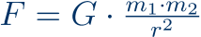




The Scientific Method
Observation
Hypothesis
Prediction
Experiment

Slide 4
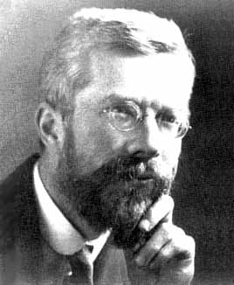
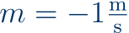

The Scientific Method for Statistical Modelling
Observation
measure data
Hypothesis
choose model
Prediction
estimate/learn model
evaluate/validate model
Experiment
Action

Slide 5

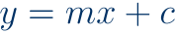
Example: Predicting the future

Slide 6
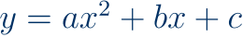

Example: Predicting the future

Slide 7
Example: Predicting the future

Slide 8
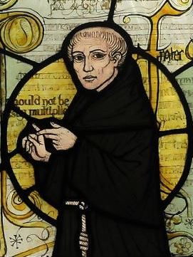
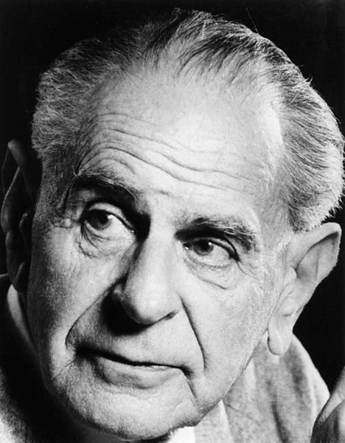
Which model/method is best?
Occam‘s razor = law of parsimony:
Frustra fit per plura quod potest fieri per pauciora.
William of Ockham, in: Summa Totius Logicae
Entia non sunt multiplicanda praeter necessitatem.
A more popular rephrasing by John Punch
= the simplest model/most intuitive method is best
Problem: what does „simple“ or „intuitive“ mean?
Falsifiability/prediction strength:
[a good model] must accurately describe a large class of observations on the basis of a model that contains only a few arbitrary elements, and it must make definite predictions about the results of future observations.
S. Hawking (after K. Popper), in: A Brief History of Time
= the simple model with lowest (prediction) error is best
Problem: how to predict the prediction error?

Slide 9
Occam‘s razor (semi-quantitative version)
best fit
error
generalization error
overfitting
underfitting
training error
model complexity
Never make your model more complicated than the data!

Slide 10







Statistical Learning Theory
Estimator

Slide 11





Statistical Learning Theory
Estimator
Predictor/ Classifier

Slide 12

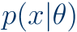










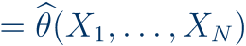

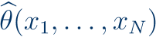
What is Parametric Estimation?

Slide 13


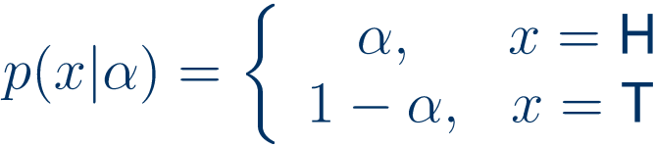


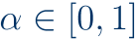
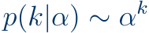




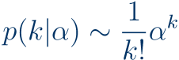


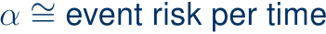
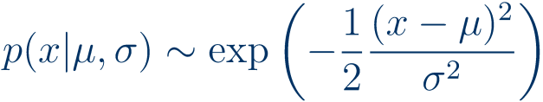
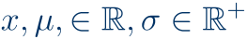

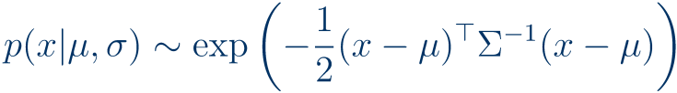
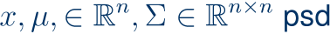
Important Parametric Distributions

Slide 14

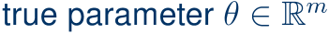
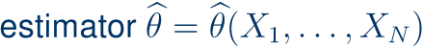

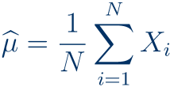

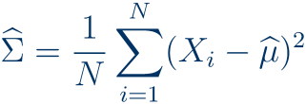

MSE in parametric estimation
Mean estimator

Slide 15

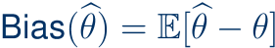

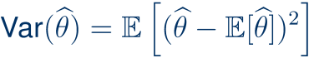

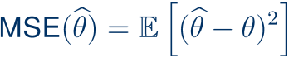
How good is an estimator? Bias and variance

Slide 16


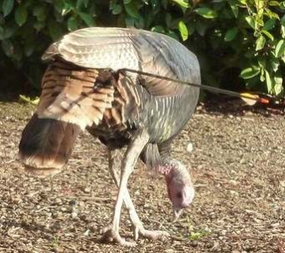
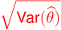


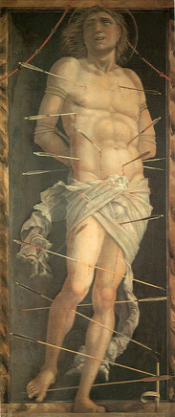
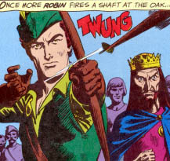
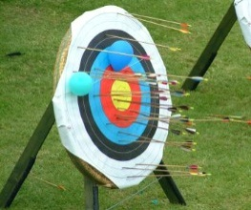

Bias and variance

Slide 17

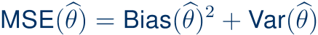

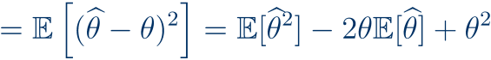

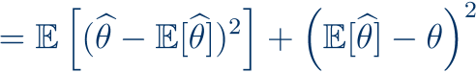
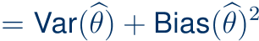
Bias-variance-tradeoff

Slide 18
Bias-variance-tradeoff
best fit
MSE
generalization error
overfitting
low bias, high variance
underfitting
high bias, low variance
training error
model complexity

Slide 19



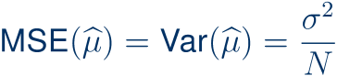
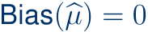
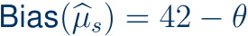
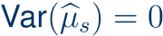
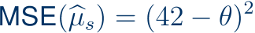
Example: mean of Gaussian

Slide 20
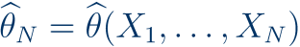

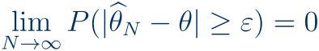
Consistency

Slide 21



Parametric Estimation Methods Overview

Slide 22
The Method of Moments
(K. Pearson, 1880s)

Slide 23
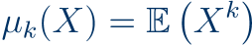

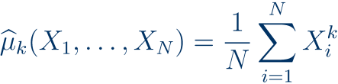
Moments

Slide 24
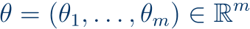


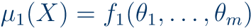
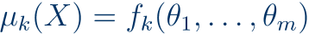

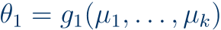
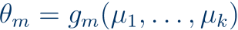


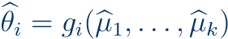
The Method of Moments

Slide 25












The Method of Moments: Examples

Slide 26













The Method of Moments: Examples

Slide 27






Important Example: The Standard Error

Slide 28





The Method of Moments: Poisson again

Slide 29
Maximum Likelihood Estimation
(Edgeworth, 1900s; Fisher, 1910s)

Slide 30


The Maximum Likelihood Estimator

Slide 31


The MLE for the i.i.d. sampling scenario

Slide 32






Maximum Likelihood Estimation: Recipe

Slide 33












Maximum Likelihood Estimation: Examples

Slide 34






Maximum Likelihood Estimation: Examples

Slide 35



Central Limit Theorem for the MLE

Slide 36
Confidence Intervals for the MLE

Slide 37








Confidence Intervals for the MLE

Slide 38




Confidence Intervals for the MLE

Slide 39


Confidence Intervals for the MLE

Slide 40



Confidence Intervals for the MLE

Slide 41
Maximum a-posteriori

Slide 42



The Maximum a-posteriori Estimator

Slide 43
Minimum variance unbiased

Slide 44
Parametric Estimation Methods Overview

Slide 45
Which estimator is best? A Paradox

Slide 46
Occam‘s razor (semi-quantitative version)
best fit
error
generalization error
overfitting
underfitting
training error
model complexity
Which estimator is best?

Slide 47




The James-Stein paradox

Slide 48





The James-Stein paradox

Slide 49

What is Parametric Estimation?

Slide 50

Questions?

